Slide 1
CpE111
Introduction to Computer Engineering
Dr. Minsu Choi
CH 9: Sequential Logic Networks

Slide 2
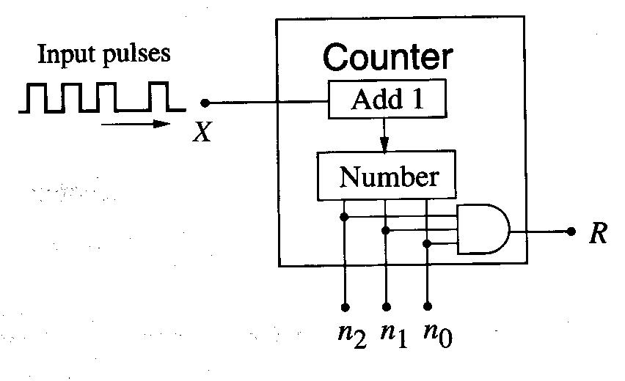
Sequential Logic Networks?
A sequential logic network is a digital system where the output is determined by both the present input and the result of a previous event.
Ex) 3-bit counter

Slide 3
Formal Description of the System: State Diagram
We define each possible value of the word as a distinct state of the machine.

Slide 4
Sequential Network Requirements
A combinational logic network to perform Boolean operations.
A memory element that stores the result of an earlier event.
If we require a clock signal to synchronize the events, it is called “synchronous logic network”, also.
Clocking signal convention: T = 1 is assumed.
(t-1) to t called previous cycle, t to (t+1) called present cycle and (t+1) to (t+2) called next clock cycle.

Slide 5
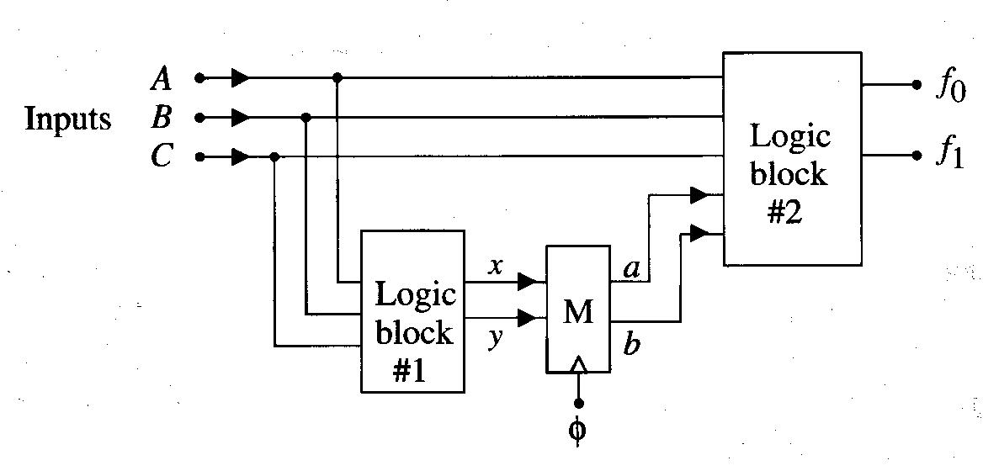
Ex) General Sequential Network #1
Two combinational logic blocks #1 and #2 and a state element (a clocked memory) M.

Slide 6
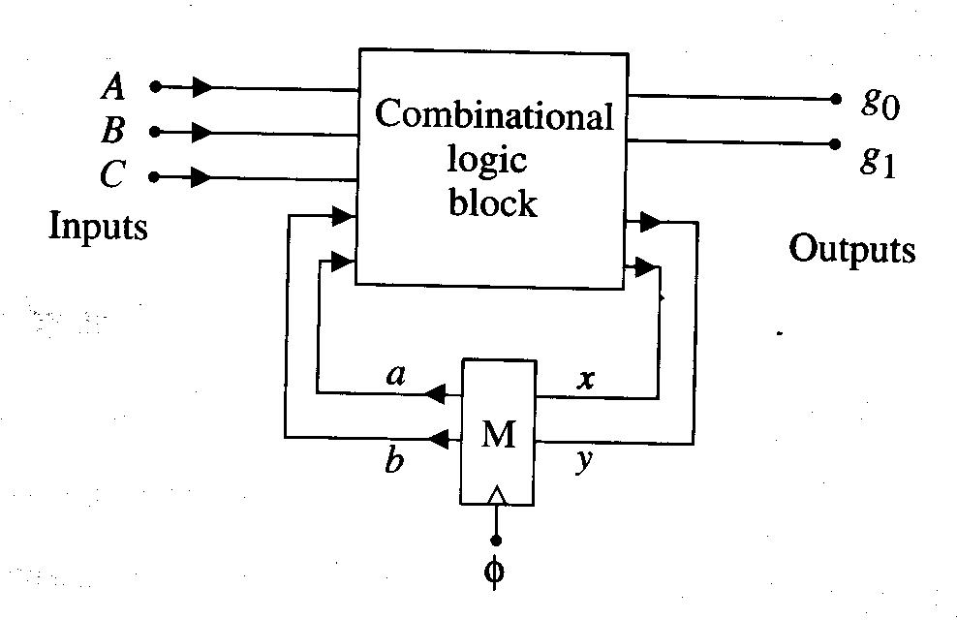
Ex) General Sequential Network #2
1 combinational logic block & 1 memory element and feedback wires.

Slide 7
Single State Variable Networks
Ex1)

Slide 8
Continued,
Ex2)

Slide 9
Continued,
Ex3)

Slide 10
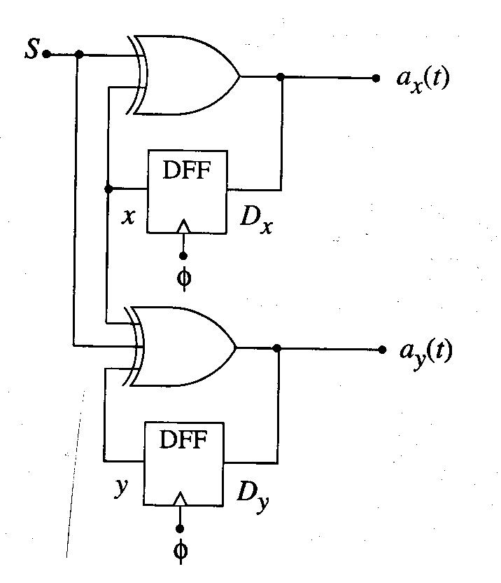
Multi-State Variable Networks
If we have n state variables, then 2^n states are needed when we draw a state diagram.
Ex)

Slide 11
State Diagram to State Table

Slide 12
Sequential Network Design
We start with a listing of the desired transition characteristics (state table, etc) and use the information to create the network.
Ex)

Slide 13
Continued,

Slide 14
Binary Counters
Ex) 2-bit counter

Slide 15
Continued,
Ex) 3-bit counter

Slide 16
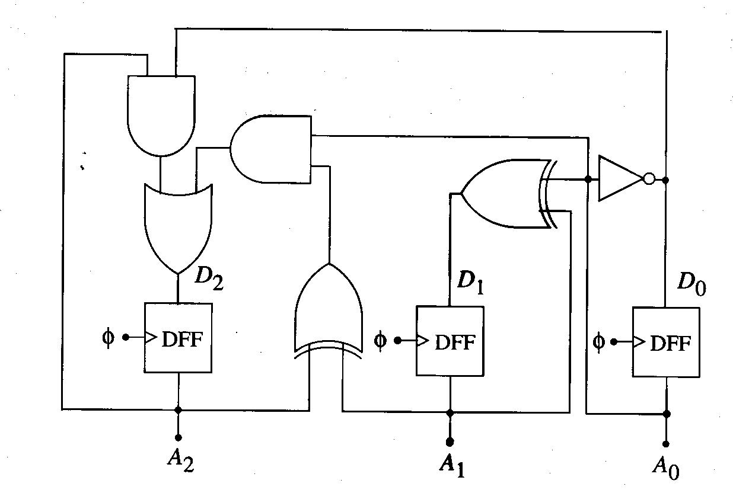
Continued,

Slide 17
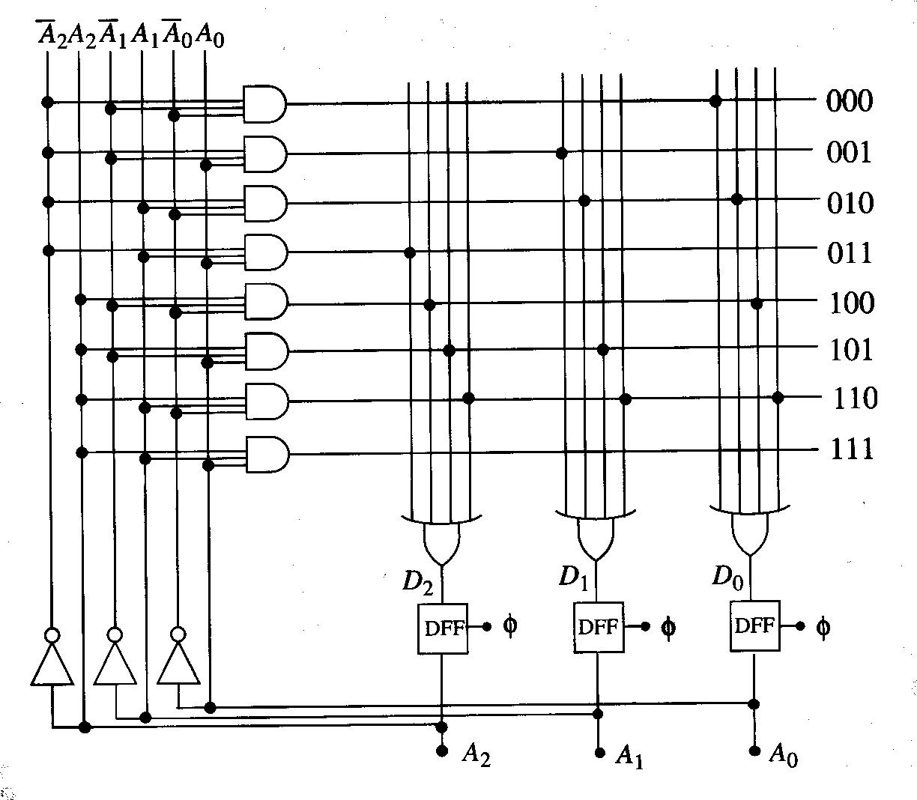
PLA Implementation of 3-Bit Counter (using SOP forms)

Slide 18
Program Completed
University of Missouri-Rolla
© 2003 Curators of University of Missouri

